Slide 1
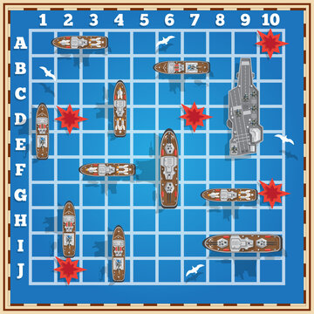
Logical Battleship presentation
Student: Alfredo Mungari – 0120000287
Exam: Artificial Intelligence
A.A: 2023/2024

Slide 2
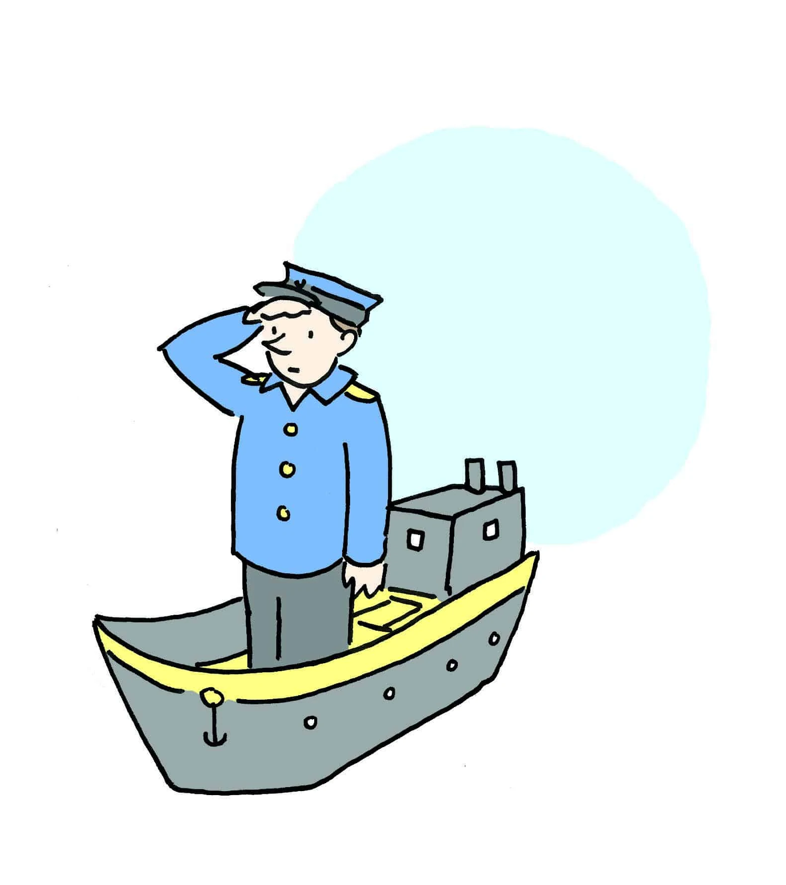
Players and components
2 players
4 tables or grids (2 for each player)
10 ships:
1 aircraft carrier
2 ironclads
3 cruisers
4 torpedo boats

Slide 3
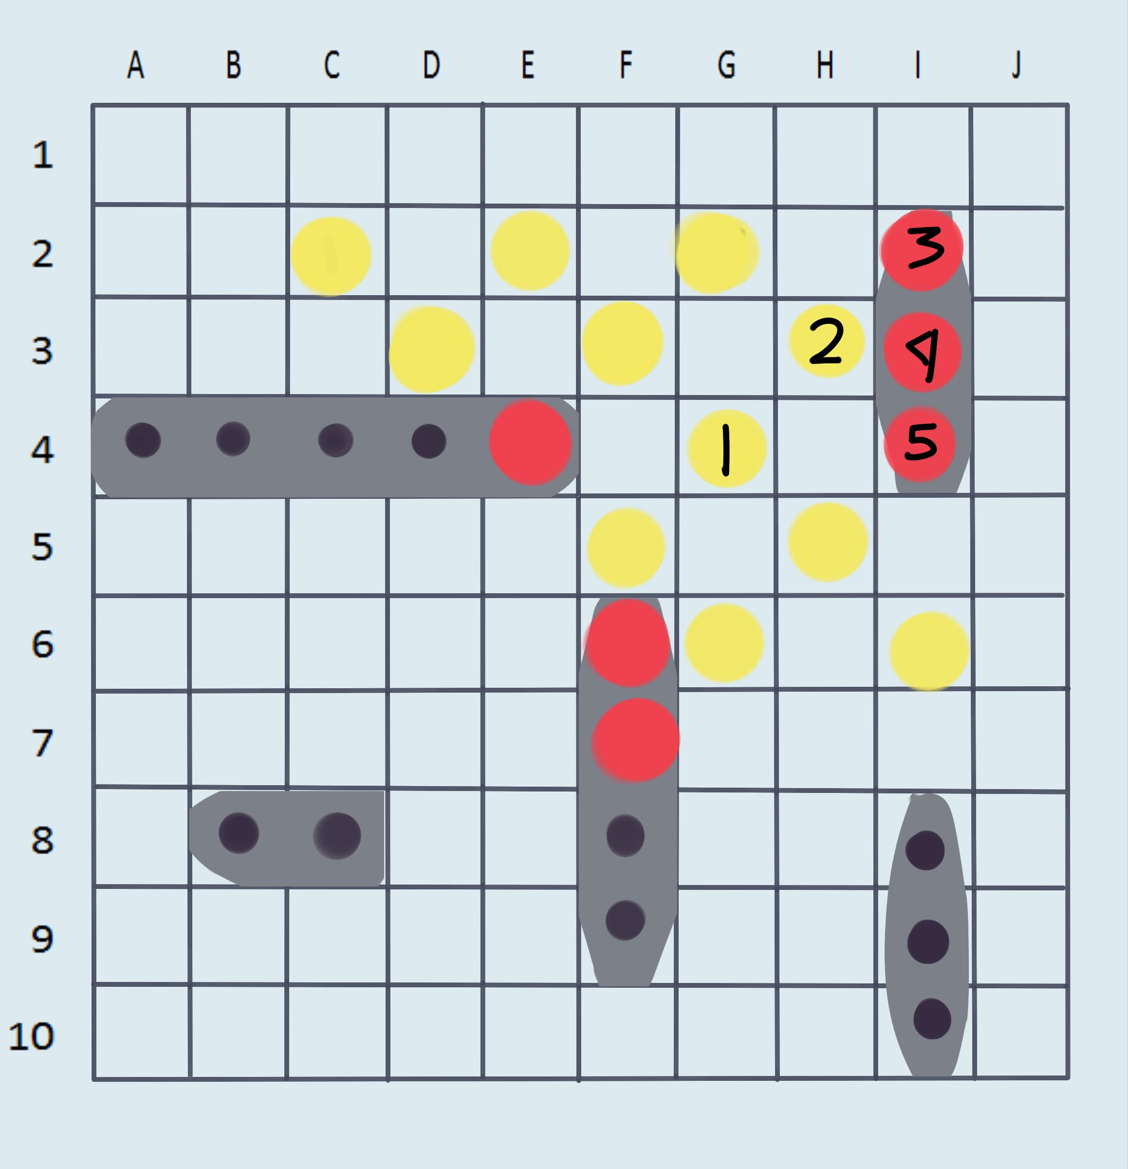
Structure
Playground structure:
Each grid is 10 x 10 in size
Letters as column indices
Numbers as row indices
Ships structure:
Aircraft carrier ➡️ 6 boxes
Ironclads ➡️ 4 boxes
Cruisers ➡️ 3 boxes
Torpedo boats ➡️ 2 boxes

Slide 4

Rules
Each player chooses where to place their ships on one of its grids
It's a turn-based game
When the players have deployed their fleet, the game begins
The player in their turn defines a coordinate pair consisting of a number (for rows) and a letter (for columns)
If the coordinate pair matches the part of a ship in the opponent's field the latter declares “hit” otherwise “miss”
If all parts of a ship have been hit the opponent declares that he has lost a ship by saying “hit and sunk”
The player on duty will mark on the second of the two grids the squares hit, missed hits, and ships centered
After each shot, the turn passes to the other player
The game is won by the first player who manages to sink all the ships in the opposing fleet

